Slide 1
Multimedia Systems
Multimedia Systems: Multimedia system overview, multimedia kernels, compression, CPU scheduling, disk scheduling.

Slide 2
Outline
What is multi-media?
Requirements and challenges for audio and video in computer systems
CD devices and formats
Systems for multimedia
Compression and bandwidth
If time:–
Processor and disk scheduling
Network streaming and management

Slide 3
What do we mean by “multimedia”
Audio and video within a computer system
CD’s & DVD’s
Computer hard drive
Interactive
Live broadcast & web casts
Radio stations, Network TV, Webcams, Skype, …
Video on demand
Pause, fast forward, reverse, etc.
Interactive activities involving audio, video, images
Meetings and presentations with 2-way audio
Teleconferencing
Handheld devices
iPod, MP-3 players; personal video; mobile phones, …

Slide 4
Multimedia Data and Delivery
Stored in file system like ordinary data.
Must be accessed with specific timing requirements.
E.g., video must be displayed at 24-30 frames per second.
System must guarantee timely delivery
Continuous-media data
– Data with specific rate requirements

Slide 5
Multimedia Characteristics
Multimedia files can be very large.
Continuous media data may require very high data rates.
Multimedia applications are usually sensitive to timing delays during playback.
Note: human ear is more sensitive to jitter in audio than eye is to jitter in video!

Slide 6
Requirements
“Smooth” audio and video
Deterioration in quality ⇒ jerky playback
Multiple concurrent streams
Video & multimedia servers
TiVo, etc.
Wide range of network bandwidths
Audio/video while PC is doing something else

Slide 7
System and OS Challenges
Bandwidths and Compression
Jitter
Processor Scheduling
Disk Scheduling
Network Streaming

Slide 8
Some System Architectures
Simple:
Data paths for audio/video that are separate from computational data paths
Modern
Fast system bus, CPU, devices
Video server
Disk farm and multiple streams

Slide 9
System Organization (a decade ago)
Memory
CPU
memory bus
audio stream
Device
CD-ROM
drive
Sound card
Separate data path for audio stream
Or headphone jack and volume control on CD drive itself
Main system bus and CPU were too busy/slow to handle real-time audio

Slide 10
System Organization (typical Pentium PC today)
Main
Memory
video stream via ISA & bridge to graphics card
Level
2
cache
CPU
Bridge
AGP Port
Graphics card
Moni-
tor
PCI bus
ISA
bridge
IDE
disk
audio stream via ISA bridge to sound card
Ether-
SCSI
USB
net
ISA bus
Mouse
Key-
Modem
Sound card
Printer
board

Slide 11
DVD devices
Similar in concept, different in details
More data, higher bandwidth
– Track spacing: | 0.834μ | vs. | 1.6μ
– Bit spacing: | 0.4μ | vs. | 0.74μ
– Capacity: | 4.7 Gbytes | vs. | 650 Mbytes

Slide 12
Compression
An essential part of audio and video representation as files

Slide 13
Why Compression? – CD-quality audio
22,050 Hz ⇒ 44,100 samples/sec
16 bits per sample
Two channels ⇒ 176,400 bytes/sec
≅ 1.4 mbits/sec
Okay for a modern PC
Not okay for 56 kb/sec modem (speed) or iPod (space)!
MP-3 ≅ 0.14 mbits/sec (10:1)
Same audio quality!
Compression ratio varies with type of music

Slide 14
Why Compression? – Video
“Standard” TV frame = 640 × 480 pixels @ 25-30 frames/sec (fps) ⇒
⇒ 9,216,000 pixels/sec = 27,648,000 bytes/sec
Hollywood “standard” movie ≤ 133 minutes
⇒ approx. 210 gigabytes (standard resolution)!
HDTV = 1280 × 720 pixels @ 30 fps
⇒ 82,944,000 bytes/sec (and rising!)
DVD holds ~ 4.7 gigabytes
⇒ average of ~ 620 kilobytes/sec!
“Standard” movie of 133 minutes requires serious compression just to fit onto DVD

Slide 15
Video Compression Requirements
Compression ratio > 50:1
i.e., 210 gigabytes:4.7 gigabytes
Visually indistinguishable from original
Even when paused
Fast, cheap decoder
Slow encoder is okay
VCR controls
Pause, fast forward, reverse

Slide 16
Video Compression Standards
MPEG (Motion Picture Experts Group)
Based on JPEG (Joint Photographic Experts Group)
Multi-layer
Layer 1 = system and timing information
Layer 2 = video stream
Layer 3 = audio and text streams
Three standards
MPEG-1 – 352×240 frames; < 1.5 mb/sec ( < VHS quality)
Layer 3 = MP3 Audio standard
Typical uses:– video clips on internet; video for handhelds
MPEG-2 – standard TV & HDTV; 1.5-15 mb/sec
DVD encoding
MPEG-4 – combined audio, video, interactive graphics
2D & 3D animations

Slide 17
JPEG compression (single frame)
Convert RGB into YIQ
Y = luminance (i.e., brightness) ~ black-white TV
I, Q = chrominance (similar to saturation and hue)
Reason: Human eye is more sensitive to luminance than to color (rods vs. cones)
Down-sample I, Q channels
i.e., average over 2×2 pixels to reduce resolution
lossy compression, but barely noticeable to eye
Partition each channel into 8×8 blocks
4800 Y blocks, 1200 each I & Q blocks (for 640 × 480)

Slide 18
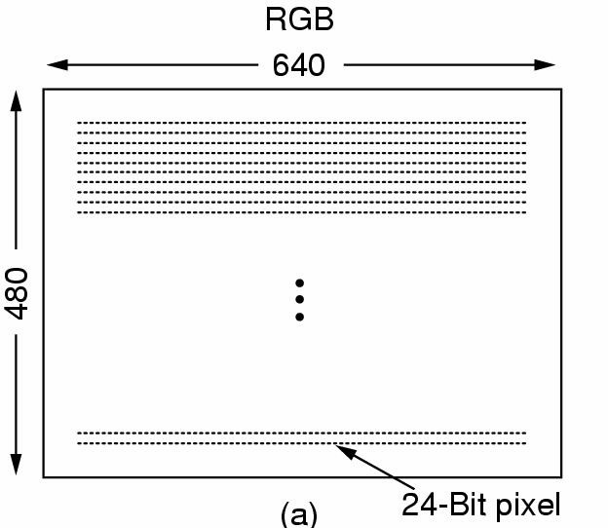
JPEG (continued)

Slide 19
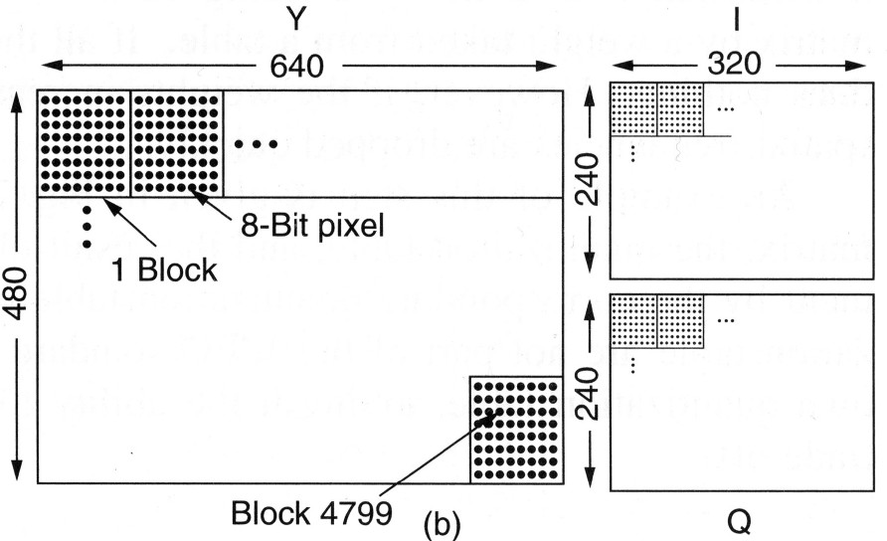
JPEG (continued)

Slide 20
JPEG (continued)
Calculate Discrete Cosine Transform (DCT) of each 8×8 block
Divide 8×8 block of DCT values by 8×8 quantization table
Effectively throwing away higher frequencies
Linearize 8×8 block, run-length encode, and apply a Huffman code to reduce to a small fraction of original size (in bytes)

Slide 21
JPEG (concluded)
7. Store or transmit 8×8 quantization table followed by list of compressed blocks
Achieves 20:1 compression with good visual characteristics
Higher compression ratios possible with visible degradation
JPEG algorithm executed backwards to recover image
Visually indistinguishable from original @ 20:1
JPEG algorithm is symmetric
Same speed forwards and backwards

Slide 22
MPEG
JPEG-like encoding of each frame
Takes advantage of temporal locality
I.e., each frame usually shares similarities with previous frame
⇒ encode and transmit only differences
Sometimes an object moves relative to background
⇒ find object in previous frame, calculate difference, apply motion vector

Slide 23
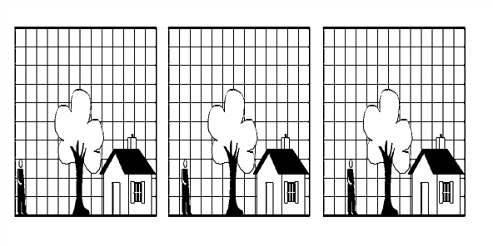
Temporal Locality (example)
Consecutive Video Frames

Slide 24
MPEG organization
Three types of frames
I-frame: Intracoded or Independent.
Full JPEG-encoded frame
Occurs at intervals of a second or so
Also at start of every scene
P-frame: Predictive frame
Difference from previous frame
B-frame: Bidirectional frame
Like p-frame but difference from both previous and next frame
I | B | B | B | P | B | B | B | P | B | B | B | P | B | B | B | I | B | B | B | P | B | B | B | P

Slide 25
MPEG Characteristics
Non-uniform data rate!
Compression ratios of 50:1 – 80:1 are readily obtainable
Asymmetric algorithm
Fast decode (like JPEG)
Encode requires image search and analysis to get high quality differences
Cheap decoding chips available for
graphics cards
DVD players, etc.

Slide 26
MPEG Problem – Fast Forward/Reverse
Cannot simply skip frames
Next desired frame might be B or P derived from a skipped frame
Options:
Separate fast forward and fast reverse files
MPEG encoding of every nth frame
Often used in video-on-demand server
Display only I and P frames
If B frame is needed, derive from nearest I or P

Slide 27
“Movie” File Organization
One MPEG-2 video stream
Possible fast forward, fast reverse sub-streams
Multiple audio streams
Multiple languages
Multiple text streams
Subtitles in multiple languages
All interleaved
Possibly in multiple files!

Slide 28
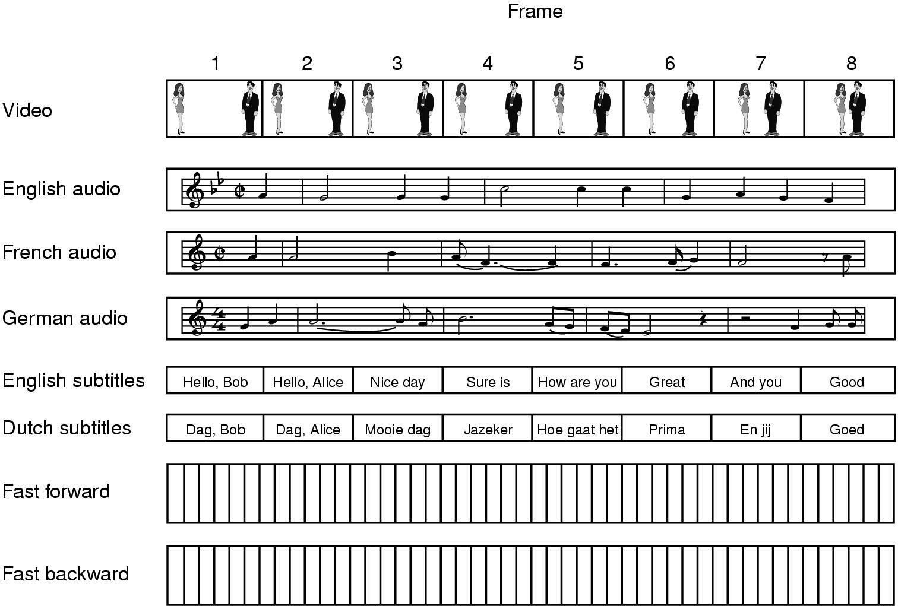
Frame

Slide 29
Operating System Challenge
How to get the contents of a movie file from disk or DVD drive to video screen and speakers.
Fixed frame rate (25 or 30 fps)
Steady audio rate
Bounded jitter
Such requirements are known as Quality-of-Service
(QoS) guarantees.
Classical problem in real-time scheduling
Obscure niche become mainstream!

Slide 30
QoS Guarantees
Building a system to guarantee QoS effects the following:–
CPU processing
Scheduling and interrupt handling
File systems
Network protocols

Slide 31
Requirement of Multimedia Operating Systems
There are three levels of QoS
Best-effort service: the system makes a best effort with no attempt to guarantee
Soft QoS: allows different traffic streams to be prioritized, but no QoS guarantees are made
Hard QoS: system ensures QoS requirements are always met
Prioritization
Admission control
Bounded latency on interrupt handling, processing, etc.

Slide 32
Parameters Defining QoS
Throughput: the total amount of work completed during a specific time interval
Delay: the elapsed time from when request is first submitted to desired result
Jitter: delays that occur during playback of a stream.
Reliability: how errors are handled during transmission and processing of continuous media

Slide 33
Further QoS Issues
QoS may be negotiated between the client and server.
Operating systems may use an admission control algorithm
– Admits a request for service only if the server has sufficient resources to satisfy the request

Slide 34
Two common methods
Rate Monotonic Scheduling
Earliest Deadline First
Many variations
Many analytic methods for proving QoS (Quality of Service)

Slide 35
Processor Scheduling for Real-Time Rate Monotonic Scheduling (RMS)
Assume m periodic processes
Process i requires t_{i} msec of processing time every
p_{i} msec.
Equal processing every interval — like clockwork!

Slide 36
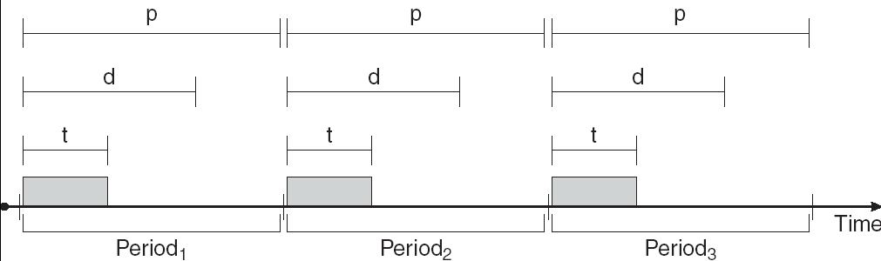
Example
Periodic process i requires the CPU at specified intervals (periods)
p_{i} is the duration of the period
t_{i} is the processing time
d_{i} is the deadline by when the process must be serviced
– Often same as end of period

Slide 37
Processor Scheduling for Real-Time
Rate Monotonic Scheduling (RMS)
Assume m periodic processes
Process i requires t_{i} msec of processing time every p_{i}
msec.
Equal processing every interval — like clockwork!
m
t
∑
i
p_{i}
≤ 1
Assume
i=1
1
p_{i}
Assign priority of process i to be
– Statically assigned
Let priority of non-real-time processes be 0

Slide 38
Rate Monotonic Scheduling (continued)
Scheduler simply runs highest priority process that is ready
May pre-empt other real-time processes
Real-time processes become ready in time for each frame or sound interval
Non-real-time processes run only when no real- time process needs CPU

Slide 39
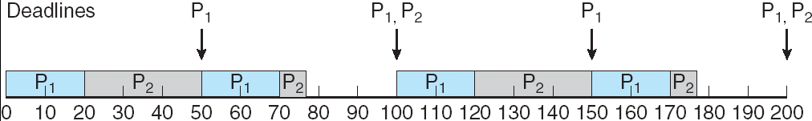
Example
p₁ = 50 msec; t₁ = 20 msec
p₂ = 100 msec; t₂ = 35 msec
Priority(p₁) > Priority(p₂)
Total compute load is 75 msec per every 100 msec.
Both tasks complete within every period
25 msec per 100 msec to spare

Slide 40
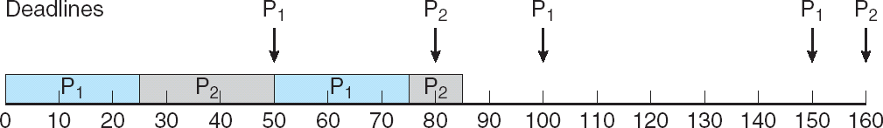
Example 2
p₁ = 50 msec; t₁ = 25 msec
p₂ = 80 msec; t₂ = 35 msec
Priority(p₁) > Priority(p₂)
Total compute load is (25/50)+(35/80) = 0.94 = ~ 94% of CPU.
Cannot complete both tasks within some periods
Even though there is still CPU capacity to spare!

Slide 41
Processor Scheduling for Real-Time Earliest Deadline First (EDF)
When each process i become ready, it announces deadline D_{i} for its next task.
Scheduler always assigns processor to process with earliest deadline.
May pre-empt other real-time processes

Slide 42
Earliest Deadline First Scheduling (continued)
No assumption of periodicity
No assumption of uniform processing times
Theorem: If any scheduling policy can satisfy QoS requirement for a sequence of real time tasks, then EDF can also satisfy it.
– Proof: If i scheduled before i+1, but D_{i+1} < D_{i} , then i and i+1 can be interchanged without affecting QoS guarantee to either one.

Slide 43
Earliest Deadline First Scheduling
EDF is more complex scheduling algorithm
Priorities are dynamically calculated
Processes must know deadlines for tasks
EDF can make higher use of processor than RMS
Up to 100%
There is a large body of knowledge and theorems about EDF analysis

Slide 44
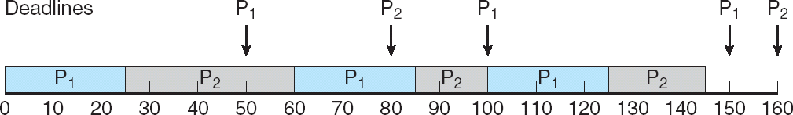
Example 2 (again)
Priorities are assigned according to deadlines:
the earlier the deadline, the higher the priority;
the later the deadline, the lower the priority.
18/04/2018
44

Slide 45
Network Management (continued)
Broadcasting
Like cable TV
Fixed portion of network bandwidth dedicated to set of broadcast streams; inflexible
Multicasting
Typical webcast
Multicast tree set up through internet to reach customers
Customers can come and go
Unicast
Dedicated connection between server and client
Streaming version of familiar transport protocols

Slide 46
Streaming – Delivery of Multimedia Data over Network
Two types of streaming:–
Progressive download: client begins playback of multimedia file during delivery.
File is ultimately stored on client computer
(Hopefully) download speed > playback speed
Real-time streaming: multimedia file is delivered to, but not stored on, client computer
Played back at same speed as delivery
Limited amount of buffering to remove jitter

Slide 47
Two Types of Real-time Streaming
Live streaming: to deliver a live event while it is occurring.
Broadcast or multicast
On-demand streaming: to deliver archived media streams
Movies, lectures, old TV shows, etc.
Events not delivered when they occur.
Playback with pause, fast forward, reverse, etc
Unicast (usually)

Slide 48
Network Streaming
Traditional HTTP
Stateless
Server responds to each request independently
Real-Time Streaming Protocol (RTSP)
Client initiates a “push” request for stream
Server provides media stream at frame rate

Slide 49
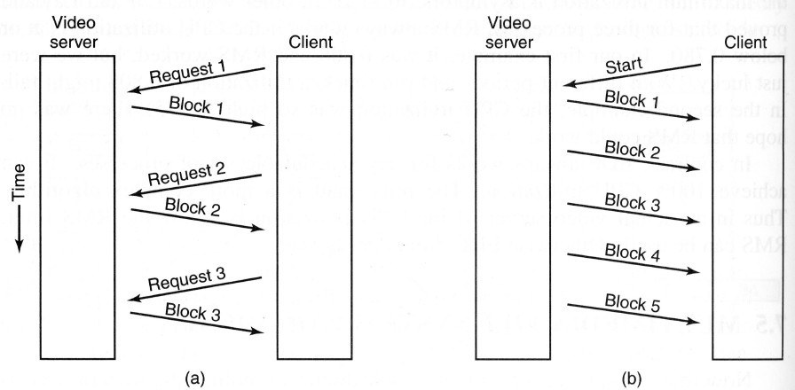
Pull (HTTP) vs. Push (RTSP) server

Slide 50
RTSP States
SETUP: server allocates resources for client session.
PLAY: server delivers stream to a client session.
PAUSE: server suspends delivery of a stream.
TEARDOWN: server releases resources and breaks down connection.

Slide 51
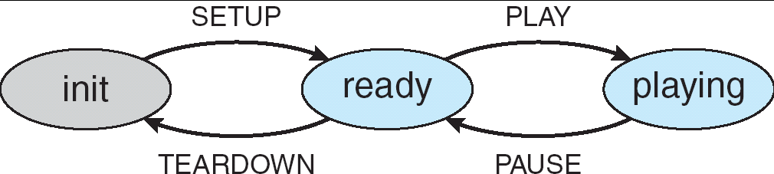
RTSP state machine

Slide 52
Bandwidth Negotiation
Client application provides feedback to server to adjust bandwidth
E.g.,
Windows Media Player
RealPlayer
Quicktime

Slide 53
Video Server
Multiple CPUs
Disk farm
1000s of disks
Multiple high-bandwidth network links
Cable TV
Video on demand
Internet

Slide 54
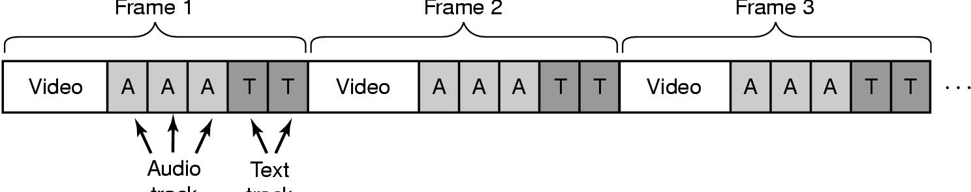
Multimedia File & Disk Management
Single movie or multimedia file on disk
Interleave audio, video, etc.
So temporally equivalent blocks are near each other
Attempt contiguous allocation
Avoid seeks within a frame
Audio
Frame
Text Frame

Slide 55
File organization – Frame vs. Block
Frame organization
Small disk blocks (4-16 Kbytes)
Frame index entries point to starting block for each frame
Frames vary in size (MPEG)
Advantage: very little storage fragmentation
Disadvantage: large frame table in RAM
Block organization
Large disk block (256 Kbytes or more)
Block index entries point to first I-frame of a sequence
Multiple frames per block
Advantage: much smaller block table in RAM
Disadvantage: large storage fragmentation on disk

Slide 56
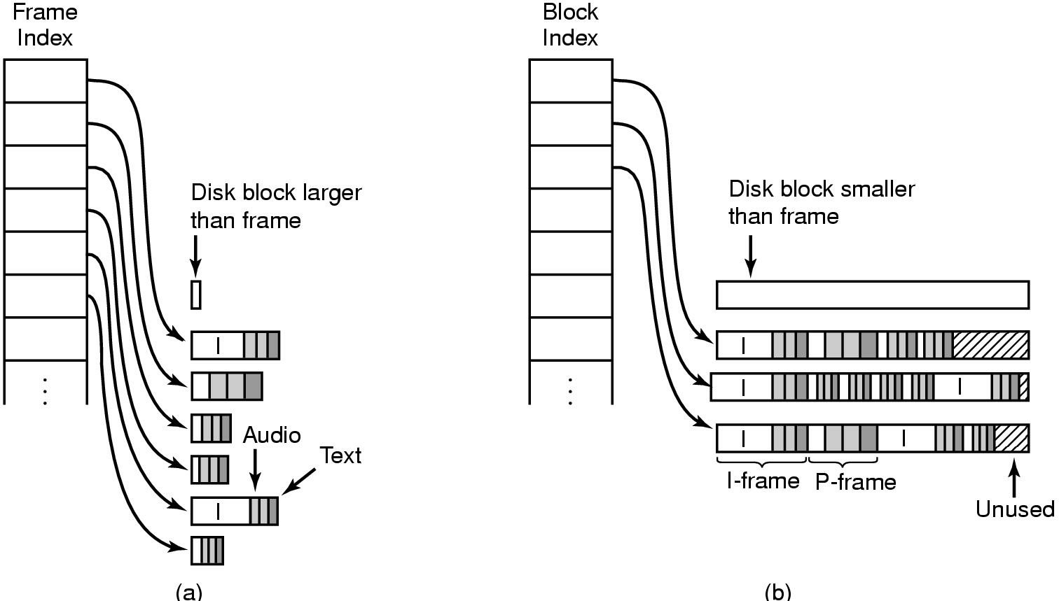
Frame vs. Block organization
smaller
larger

Slide 57
File Placement on Server
Random
Striped
“Organ pipe” allocation
Most popular video in center of disk
Next most popular on either side of it, etc.
Least popular at edges of disk
Minimizes seek distance

Slide 58
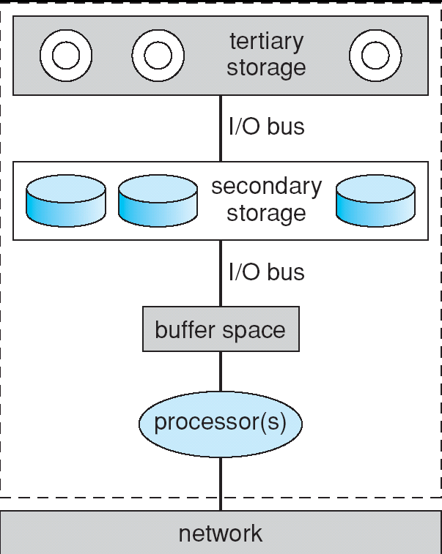
Resources on a file server

Slide 59
Conclusion
Multimedia computing is challenging
Possible with modern computers
Compression is essential, especially for video
Real-time computing techniques move into mainstream
Processor and disk scheduling
There is much more to this subject than fits into one class

Slide 60
Thank You

